Slide 1
C++ Programming:
From Problem Analysis to Program Design, Third Edition
Chapter 7: User-Defined Functions II

Slide 2
Objectives
In this chapter you will:
Learn how to construct and use void functions in a program
Discover the difference between value and reference parameters
Explore reference parameters and value-returning functions
Learn about the scope of an identifier

Slide 3
Objectives (continued)
Examine the difference between local and global identifiers
Discover static variables

Slide 4
Void Functions
Void functions and value-returning functions have similar structures
  Both have a heading part and a statement part
User-defined void functions can be placed either before or after the function main

Slide 5
Void Functions (Continued)
The program execution always begins with the first statement in the function main
If user-defined void functions are placed after the function main
  The function prototype must be placed before the function main

Slide 6
Void Functions (continued)
A void function does not have a return type
The return statement without any value is typically used to exit the function early
Formal parameters are optional
If we do not mention any return type of function, it will return an int value which is a default return type of function.

Slide 7


void Functions Without Parameters
Function definition syntax:
void is a reserved word
Function call syntax:

Slide 8

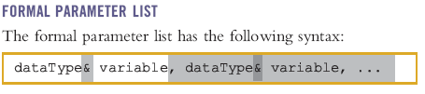
void Functions With Parameters
Function definition syntax:

Slide 9
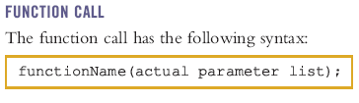


Slide 10
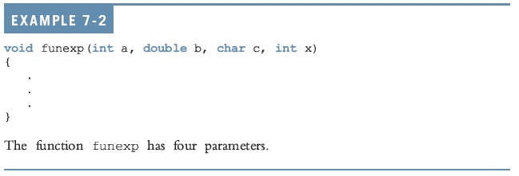
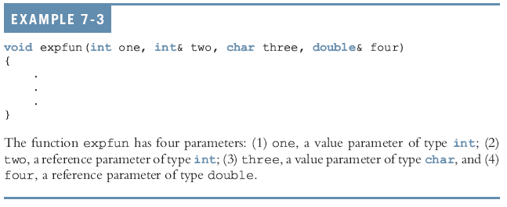

Slide 11
void Functions With Parameters (continued)
Value Parameter - a formal parameter receives a copy of the content of corresponding actual parameter
Reference Parameter - a formal parameter that receives the location (memory address) of the corresponding actual parameter

Slide 12
Value Parameters
If a formal parameter is a value parameter
  The value of the corresponding actual parameter is copied into it
The value parameter has its own copy of the data
During program execution
  The value parameter manipulates the data stored in its own memory space

Slide 13
Reference Variables as Parameters
If a formal parameter is a reference parameter
  It receives the address of the corresponding actual parameter
A reference parameter stores the address of the corresponding actual parameter

Slide 14
Reference Variables as Parameters (continued)
During program execution to manipulate the data
  The address stored in the reference parameter directs it to the memory space of the corresponding actual parameter

Slide 15
Reference Variables as Parameters (continued)
A reference parameter receives the address of the actual parameter
Reference parameters can:
  Pass one or more values from a function
  Change the value of the actual parameter

Slide 16
Reference Variables as Parameters (continued)
Reference parameters are useful in three situations:
  Returning more than one value
  Changing the actual parameter
  When passing the address would save memory space and time

Slide 17
Reference Variables as Parameters (continued)
#include <iostream>
using namespace std;
void multiply(int a, int b, int& product, int& sum) {
product = a * b;
sum = a + b;
}
int main() {
int a = 5;
int b = 7;
int product, sum;
multiply(a, b, product, sum);
cout << "Product: " << product << endl;
cout << "Sum: " << sum << endl;
return 0;
}

Slide 18
Parameters & Memory Allocation
When a function is called
  Memory for its formal parameters and variables declared in the body of the function (called local variables) is allocated in the function data area
In the case of a value parameter
  The value of the actual parameter is copied into the memory cell of its corresponding formal parameter

Slide 19
Parameters & Memory Allocation (continued)
In the case of a reference parameter
  The address of the actual parameter passes to the formal parameter
Content of the formal parameter is an address

Slide 20
Parameters & Memory Allocation (continued)
During execution, changes made by the formal parameter permanently change the value of the actual parameter

Slide 21
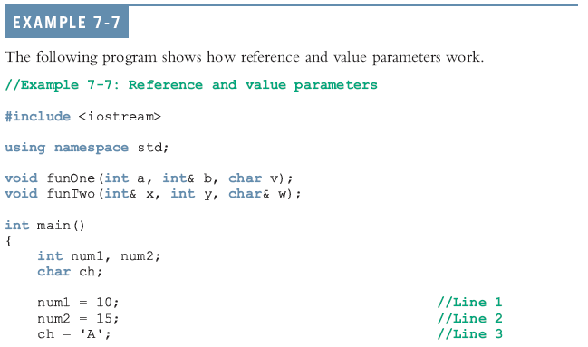

Slide 22
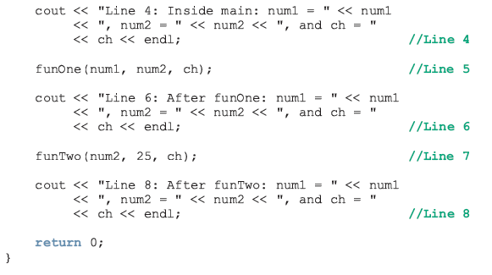

Slide 23
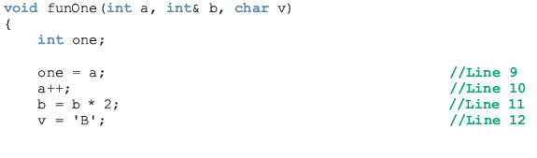

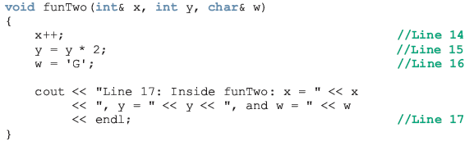

Slide 24
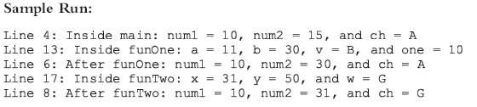

Slide 25
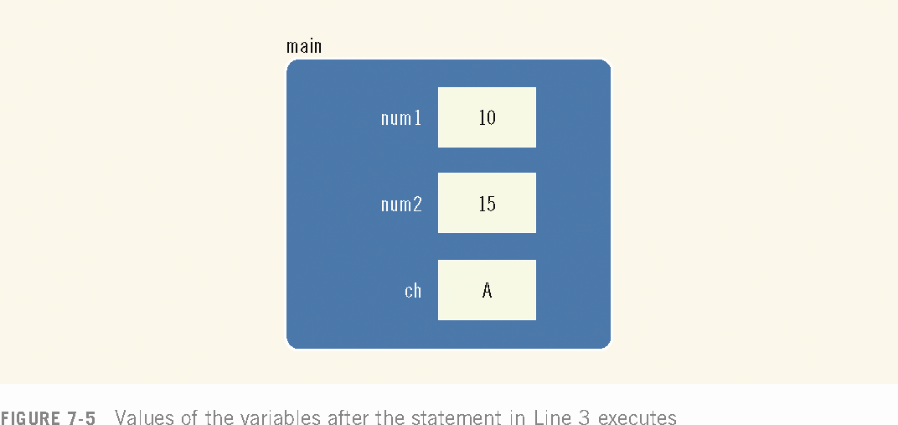

Slide 26
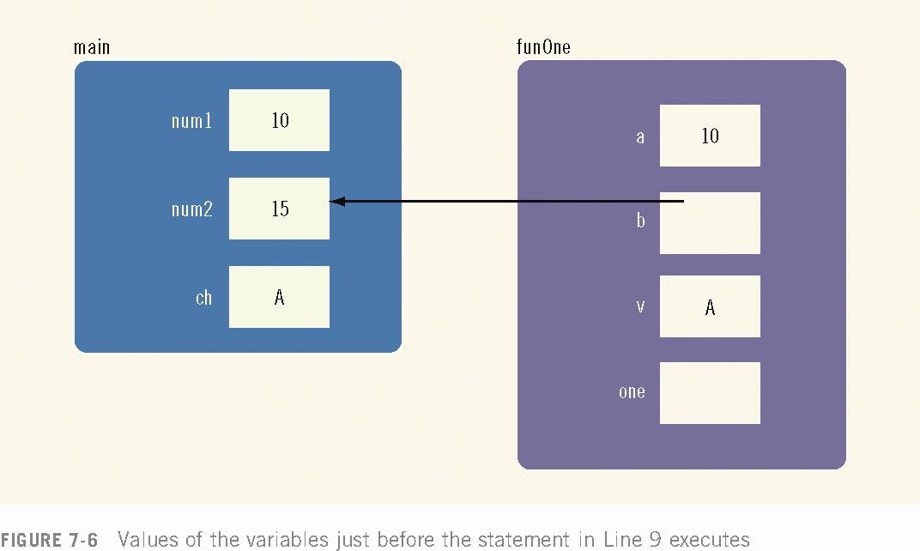

Slide 27
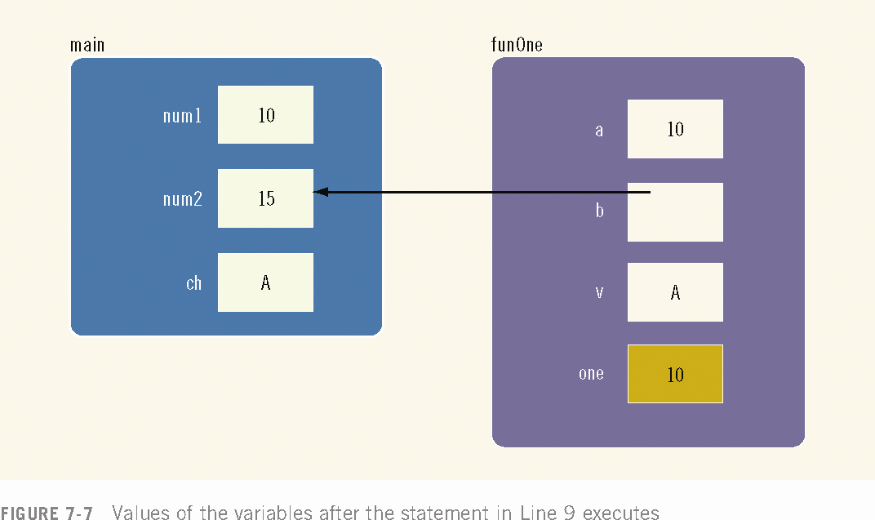

Slide 28
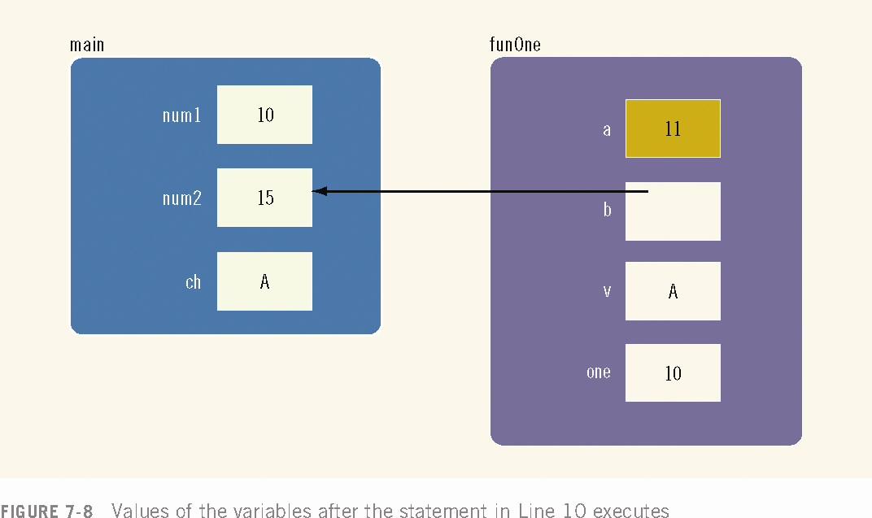

Slide 29
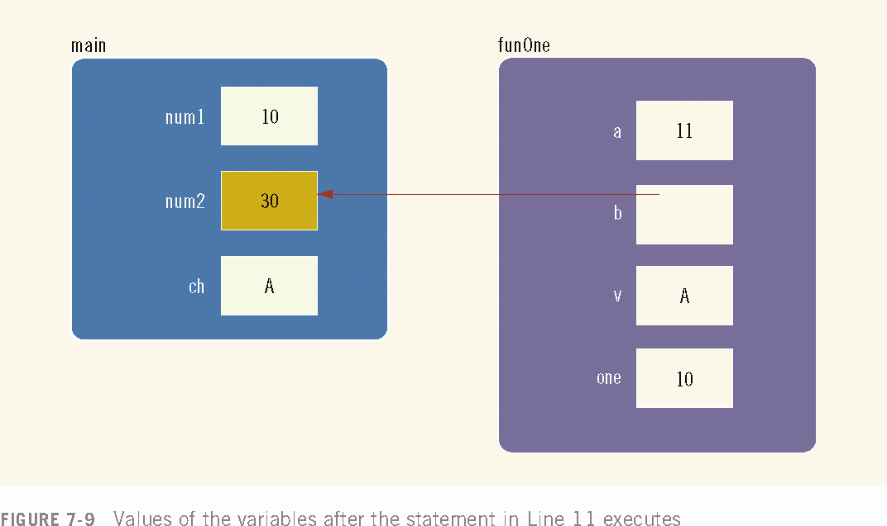

Slide 30
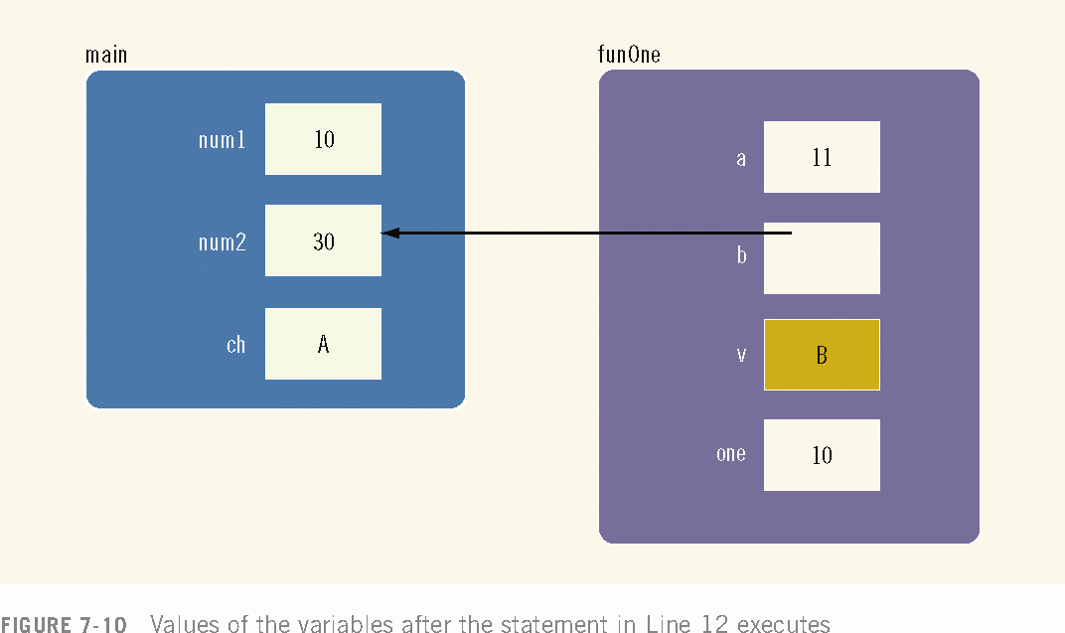

Slide 31



Slide 32

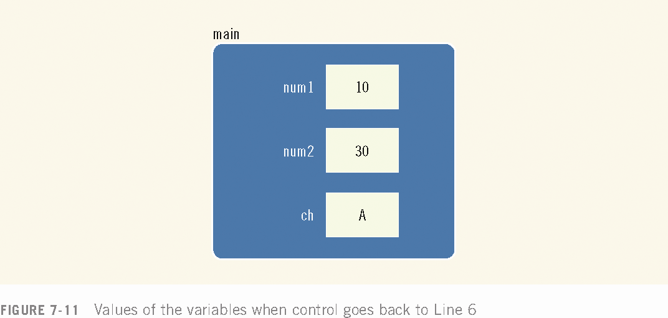


Slide 33
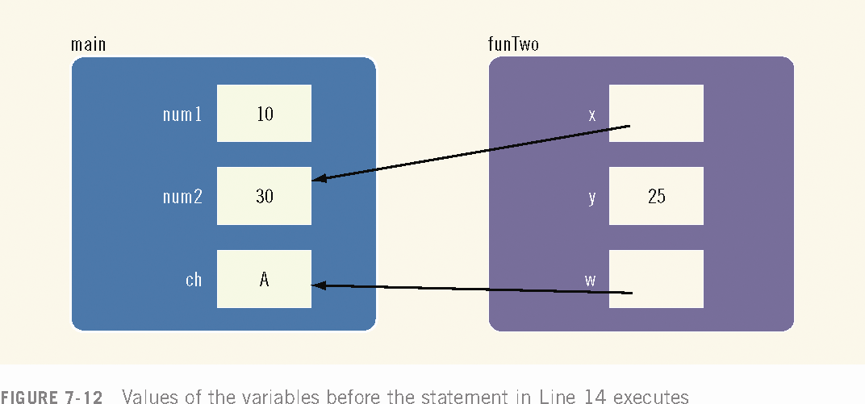

Slide 34
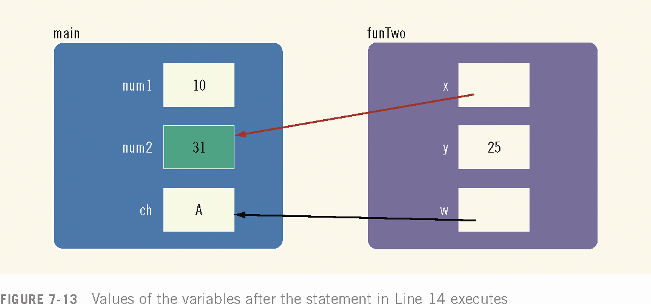

Slide 35
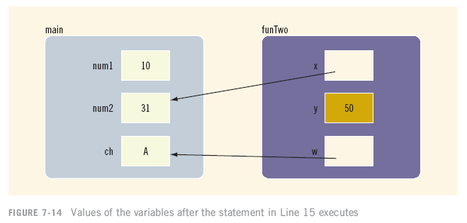

Slide 36
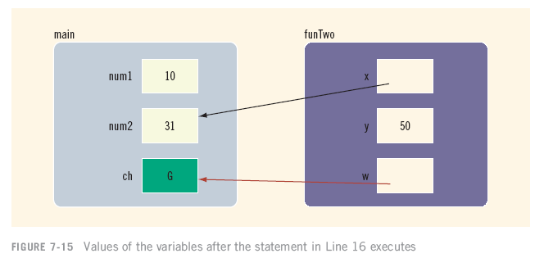

Slide 37



Slide 38




Slide 39
Scope of an Identifier
The scope of an identifier refers to where in the program an identifier is accessible
Local identifier - identifiers declared within a function (or block)
Global identifier – identifiers declared outside of every function definition
C++ does not allow nested functions
  The definition of one function cannot be included in the body of another function

Slide 40
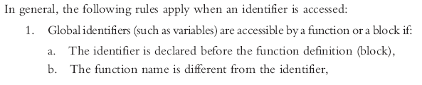
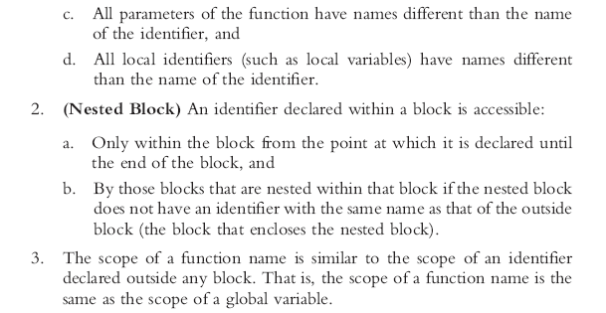

Slide 41
Global Variables
Some compilers initialize global variables to default values
The operator :: is called the scope resolution operator
By using the scope resolution operator
  A global variable declared before the definition of a function (block) can be accessed by the function (or block) even if the function (or block) has an identifier with the same name as the variable

Slide 42
Global Variables (continued) Example
#include <iostream>
using namespace std;
int x = 10; // global variable
int main() {
int x = 5; // local variable with same name as global variable
cout << "Local x = " << x << endl; // prints 5
cout << "Global x = " << ::x << endl; // prints 10 using scope resolution operator
return 0;
}

Slide 43
Global Variables (continued)
C++ provides a way to access a global variable declared after the definition of a function
In this case, the function must not contain any identifier with the same name as the global variable.
Also we must use the “extern” keyword inside the function.

Slide 44
Global Variables (continued) Example
#include <iostream>
using namespace std;
int add(int a, int b); // function prototype
int main() {
int result = add(10, 20);
cout << "Result: " << result << endl;
return 0;
}
int add(int a, int b) {
extern int c; // accessing global variable declared after the function definition
return a + b + c;
}
int c = 30; // global variable declared after the function definition

Slide 45
Side Effects of Global Variables
Using global variables has side effects
Any function that uses global variables
  Is not independent
  Usually cannot be used in more than one program

Slide 46
Side Effects of Global Variables (continued)
If more than one function uses the same global variable and something goes wrong
  It is difficult to find what went wrong and where
Problems caused by global variables in one area of a program might be misunderstood as problems caused in another area

Slide 47
Static and Automatic Variables
Automatic variable - memory is allocated at block entry and deallocated at block exit
Static variable - memory remains allocated as long as the program executes
Variables declared outside of any block are static variables
By default variables declared within a block are automatic variables
Static variable is initialized only once during the program's lifetime and retains its value between function calls
Declare a static variable within a block by using the reserved word static

Slide 48
Static and Automatic Variables (continued)
The syntax for declaring a static variable is:
static dataType identifier;
The statement
static int x;
  declares x to be a static variable of the type int
Static variables declared within a block are local to the block
Their scope is the same as any other local identifier of that block

Slide 49
Static and Automatic Variables (continued) Example
#include <iostream>
using namespace std;
void incrementCount() {
static int staticCount = 0; // static variable
int automaticCount = 0; // automatic variable
staticCount++;
automaticCount++;
cout << "Static count: " << staticCount << endl;
cout << "Automatic count: " << automaticCount << endl;
}
int main() {
incrementCount(); // prints Static count: 1, Automatic count: 1
incrementCount(); // prints Static count: 2, Automatic count: 1
incrementCount(); // prints Static count: 3, Automatic count: 1
return 0;
}

Slide 50
Static vs Global Variables
Global variables are declared outside of any function, making them accessible from any part of the program.
They have global scope, meaning they can be accessed from any function within the same file or even across multiple files if declared with the extern keyword in other files.
Global variables persist throughout the program's execution, retaining their values until the program terminates.
They are typically used when a variable needs to be accessed by multiple functions or across different translation units.

Slide 51
Static vs Global Variables (Continue)
Static variables can be declared inside functions, as well as at the global scope.
When declared inside a function, a static variable retains its value between function calls. It is initialized only once and retains its value throughout the program's execution.
When declared at the global scope, static variables are accessible only within the file in which they are declared, similar to other global variables declared without the extern keyword.
Static variables provide a way to limit the scope of a variable to a specific function or file, preventing it from being accessed or modified from other parts of the program.

Slide 52
Programming Example
In this example
  Using functions, we rewrite the program that determines the number of odds and evens from a given list of integers
  This program was first written in Chapter 5
The main algorithm remains the same:
  Initialize variables, zeros, odds, and evens to 0
  Read a number

Slide 53
Programming Example (continued)
  If the number is even, increment the even count
    If the number is also zero, increment the zero count; else increment the odd count
  Repeat Steps 2 and 3 for each number in the list

Slide 54
Programming Example (continued)
The program functions include:
  Initialize: initialize the variables, such as zeros, odds, and evens
  getNumber: get the number
  classifyNumber: determine whether the number is odd or even (and whether it is also zero); this function also increments the appropriate count
  printResults: print the results

Slide 55
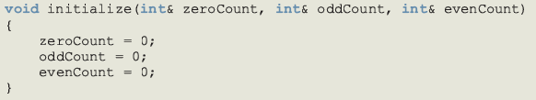


Slide 56
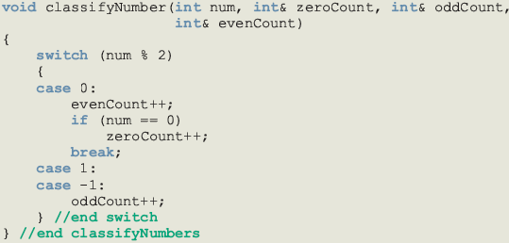

Slide 57
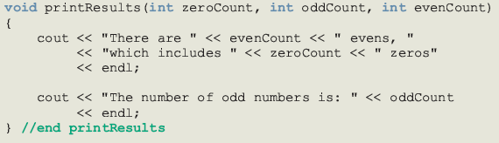

Slide 58
Main Algorithm
Call function initialize to initialize variables
Prompt the user to enter 20 numbers
For each number in the list
  Call function getNumber to read a number
  Output the number
  Call function classifyNumber to classify the number and increment the appropriate count
Call function printResults to print the final results

Slide 59
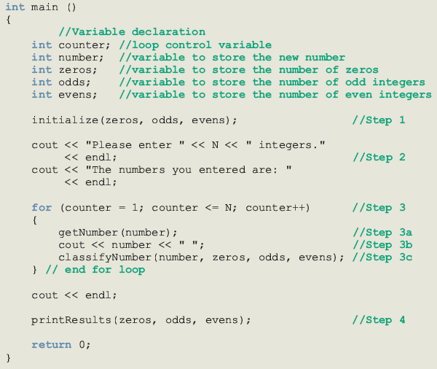

Slide 60
Summary
Void function: a function that does not have a data type
A return statement without any value can be used in a void function to exit function early
The heading of a void function starts with the word void
To call a void function, you use the function name together with the actual parameters in a stand-alone statement

Slide 61
Summary (continued)
Two types of formal parameters: value parameters and reference parameters
A value parameter receives a copy of its corresponding actual parameter
A reference parameter receives the address (memory location) of its corresponding actual parameter

Slide 62
Summary (continued)
If a formal parameter needs to change the value of an actual parameter, in the function heading you must declare this formal parameter as a reference parameter
Variables declared within a function (or block) are called local variables
Variables declared outside of every function definition (and block) are called global variables

Slide 63
Summary (continued)
An automatic variable is a variable for which memory is allocated on function (or block) entry and deallocated on function (or block) exit
A static variable is a variable for which memory remains allocated throughout the execution of the program

